Slide 1
Chapter (4)
Basic SQL (Reading)
A. Mohammed Khalifa
Karary university , Sep 2022

Slide 2
Chapter 4 Outline
1 SQL Data Definition
2 Basic Retrieval Queries in SQL
3 SQL Statements for Updating the Database

Slide 3
1 SQL Data Definition

Slide 4
SQL Data Definition
CREATE statement can be used to:
  Create a named database schema
  Create individual database tables and specify data types for the table attributes, as well as key, referential integrity, and NOT NULL constraints
  Create named constraints

Slide 5
CREATE TABLE
In its simplest form, specifies a new base relation by giving it a name, and specifying each of its attributes and their data types A constraint NOT NULL may be specified on an attribute
CREATE TABLE DEPARTMENT (
DNAME VARCHAR(15) NOT NULL,
DNUMBER INT NOT NULL,
MGRSSN CHAR(9) NOT NULL,
MGRSTARTDATE DATE );

Slide 6
CREATE TABLE (cont.)
CREATE TABLE can also specify the primary key, UNIQUE keys, and referential integrity constraints (foreign keys)
Via the PRIMARY KEY, UNIQUE, and FOREIGN KEY phrases
  CREATE TABLE DEPARTMENT (
  DNAME VARCHAR(15) NOT NULL,
  DNUMBER INT NOT NULL,
  MGRSSN CHAR(9) NOT NULL,
  MGRSTARTDATE DATE,
  PRIMARY KEY (DNUMBER),
  UNIQUE (DNAME),
  FOREIGN KEY(MGRSSN) REFERENCES EMPLOYEE);

Slide 7
Example: The COMPANY Database
Figure 3.7 (next slide) shows the COMPANY database schema diagram introduced in Chapter 3
Referential integrity constraints shown as directed edges from foreign key to referenced relation
Primary key attributes of each table underlined

Slide 9
Example: The COMPANY Database
Figure 4.1 (following two slides) shows example DDL for creating the tables of the COMPANY database
Circular reference problem:
  In Figure 3.7, some foreign keys cause circular references:
    EMPLOYEE.Dno → DEPARTMENT.Dnumber
    DEPARTMENT.Mgr_ssn → EMPLOYEE.Ssn
  One of the tables must be created first without the FOREIGN KEY in the CREATE TABLE statement
    The missing FOREIGN KEY can be added later using ALTER TABLE

Slide 10
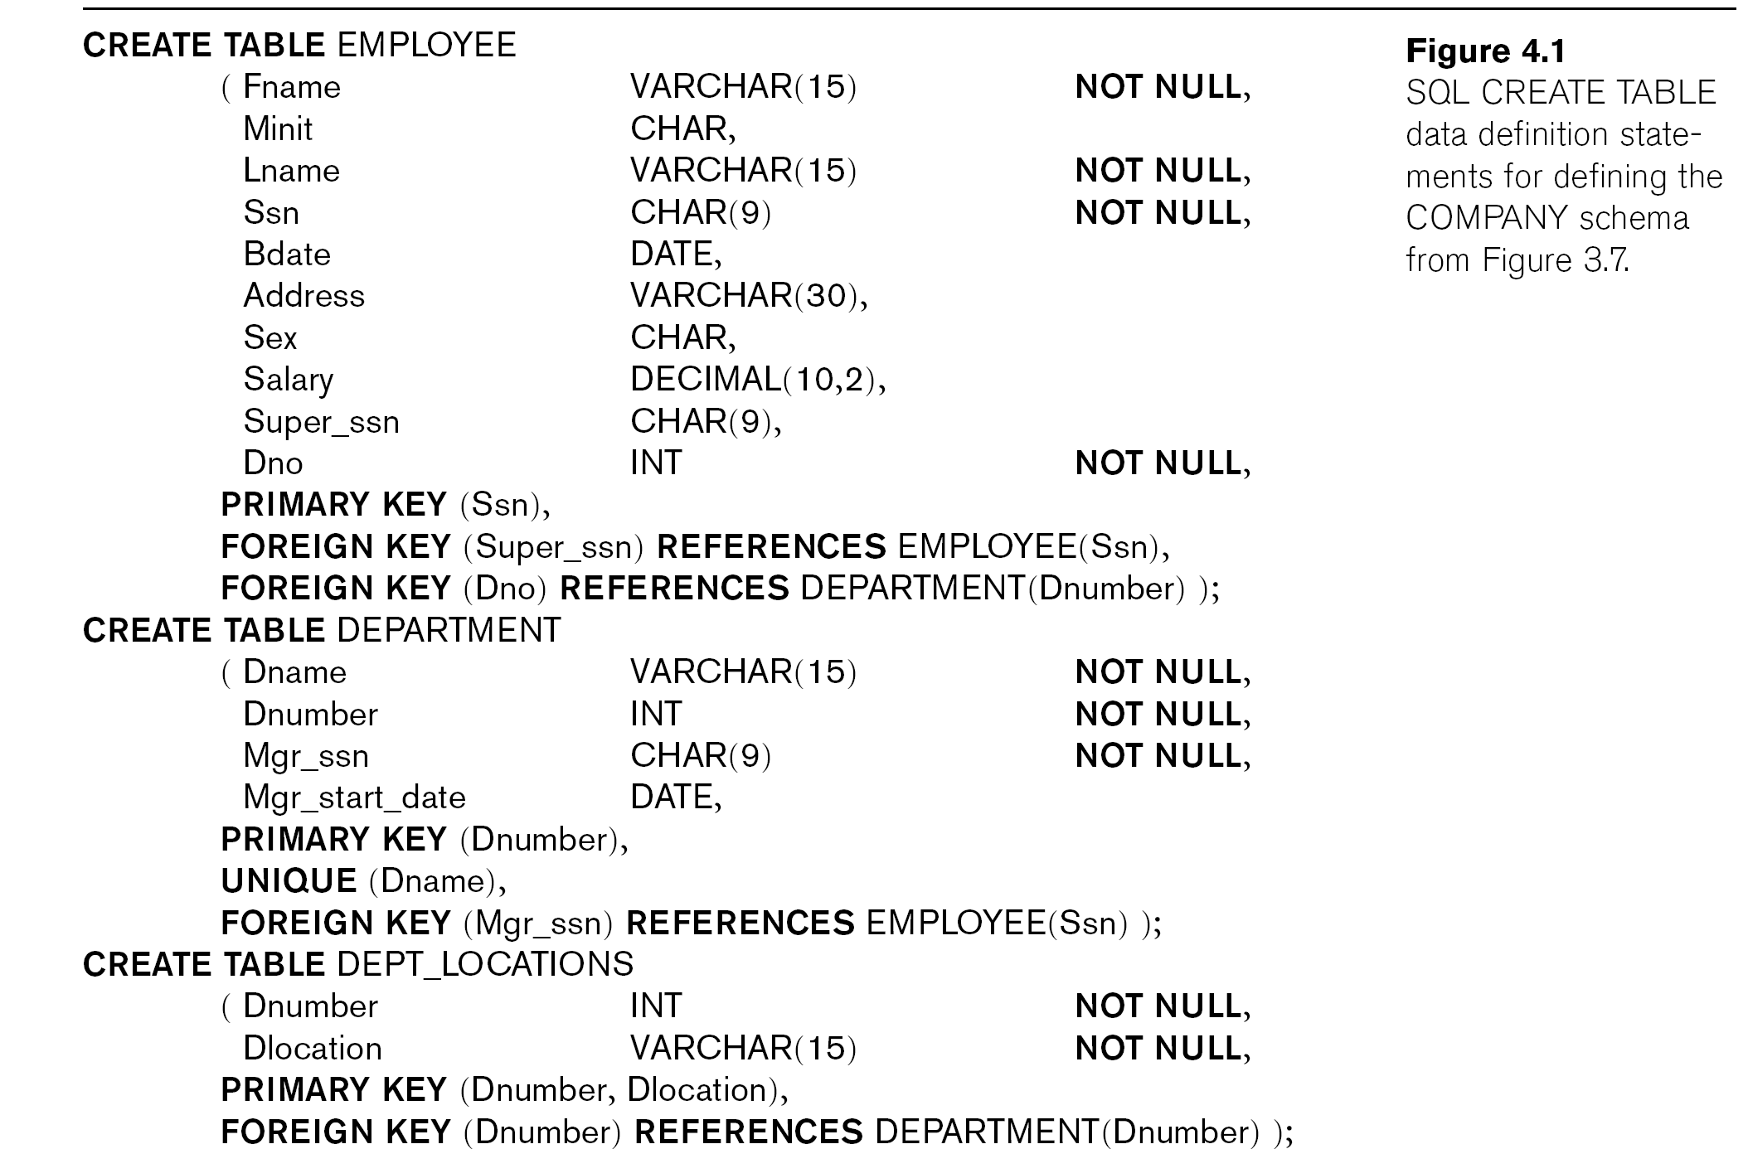
Continued next page…

Slide 11
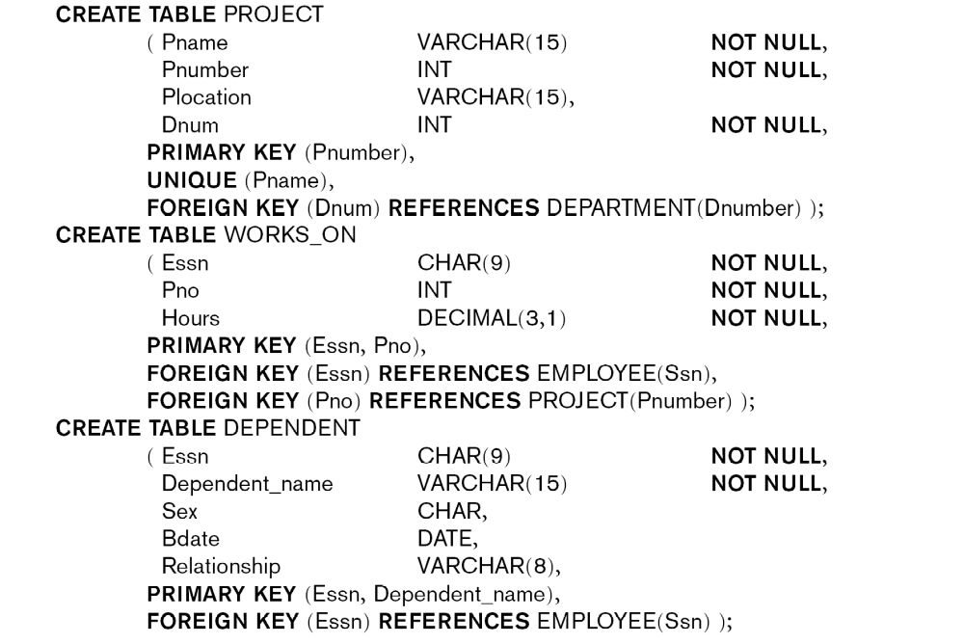

Slide 12
2 Basic Retrieval Queries in SQL

Slide 13
Basic SQL Queries
A basic query in SQL can consist of up to four clauses, but only the first two, SELECT and FROM, are mandatory
The four basic clauses are specified in the following order:
SELECT <attribute list>
FROM <table list>
[WHERE <condition>]
[ORDER BY <attribute list>]

Slide 14
Basic Retrieval Queries in SQL
Simplest form of the SQL SELECT statement is called a mapping or a SELECT-FROM-WHERE block
Our examples use the COMPANY database schema
SELECT <attribute list>
FROM <table list>
WHERE <condition>

Slide 15
Simple SQL Queries
Query text ends with a semi-colon
First example of a simple query on one table (relation)
Query 0: Retrieve the birthdate and address of the employee whose name is 'John B. Smith'
Use the EMPLOYEE table only
Query (1):
  SELECT BDATE, ADDRESS
  FROM EMPLOYEE
  WHERE FNAME='John' AND MINIT='B’
  AND LNAME='Smith’ ;

Slide 16
Simple SQL Queries (cont.)
Example of a query that uses two tables
Query 1: Retrieve the name and address of all employees who work for the 'Research' department.
Query (2):
  SELECT FNAME, LNAME, ADDRESS
  FROM EMPLOYEE, DEPARTMENT
  WHERE DNAME='Research' AND DNUMBER=DNO ;
  (DNAME='Research') is called a selection condition
  (DNUMBER=DNO) is called a join condition (it joins two tuples from EMPLOYEE and DEPARTMENT tables whenever EMPLOYEE.DNO=DEPARTMENT.DNUMBER)

Slide 17
Simple SQL Queries (cont.)
Query 2 (needs 3 tables): For every project located in 'Stafford', list the project number, the controlling department number, and the department manager's last name, address, and birthdate.
Query (3):
SELECT PNUMBER, DNUM, LNAME, BDATE, ADDRESS
FROM PROJECT, DEPARTMENT, EMPLOYEE
WHERE DNUM=DNUMBER AND MGRSSN=SSN
AND PLOCATION='Stafford' ;

Slide 18
3 SQL Statements for Updating the Database

Slide 19
SQL Statements for Updating the Database
There are three SQL commands to modify the database: INSERT, DELETE, and UPDATE
INSERT is used for adding one or more records to a table
DELETE is for removing records
UPDATE is for modifying existing records
Some operations may be rejected if they violate integrity constraints; others may propagate additional updating automatically if specified in the database schema

Slide 20
INSERT statement
Used to add one or more tuples (records) to a relation (table)
Values for the attributes should be listed in the same order as the attributes were specified in the CREATE TABLE command
Attributes that have defaults values can be omitted in the new record(s)

Slide 21
INSERT statement (cont.)
Example :
  INSERT INTO EMPLOYEE
  VALUES ('Richard','K','Marini', '653298653', '30-DEC-52',
  '98 Oak Forest,Katy,TX', 'M', 37000,'987654321', 4 ) ;
An alternate form of INSERT specifies explicitly the attribute names that correspond to the values in the new tuple
  Attributes with NULL or default values can be left out
Example: Insert a tuple for a new EMPLOYEE for whom we only know the FNAME, LNAME, and SSN attributes.
  U1A: INSERT INTO EMPLOYEE (FNAME, LNAME, SSN)
  VALUES ('Richard', 'Marini', '653298653') ;

Slide 22
DELETE Statement
Removes tuples from a relation
  Includes a WHERE-clause to select the tuples to be deleted
  Referential integrity should be enforced (via REJECT, CASCADE, SET NULL, or SET DEFAULT)
  Tuples are deleted from only one table at a time (unless CASCADE is specified on a referential integrity constraint)
  Missing WHERE-clause deletes all tuples in the relation; the table then becomes an empty table
  Number of tuples deleted is the number of tuples selected by the WHERE-clause

Slide 23
DELETE Statement (cont.)
Examples:
  1 : DELETE FROM EMPLOYEE
  WHERE LNAME='Brown' ;
  2 : DELETE FROM EMPLOYEE
  WHERE SSN='123456789’ ;
  3 : DELETE FROM EMPLOYEE
  WHERE DNO = 5 ;
  4 : DELETE FROM EMPLOYEE ;

Slide 24
UPDATE Statement
Used to modify attribute values of one or more selected tuples
A WHERE-clause selects the tuples to be modified
An additional SET-clause specifies the attributes to be modified and their new values
Each command modifies tuples in the same relation
Referential integrity should be enforced (via REJECT, CASCADE, SET NULL, or SET DEFAULT)

Slide 25
UPDATE Statement (cont.)
Example: Change the location and controlling department number of project number 10 to 'Bellaire' and 5, respectively.
  Example :
  UPDATE PROJECT
  SET PLOCATION = 'Bellaire', DNUM = 5
  WHERE PNUMBER=10 ;

Slide 26
UPDATE Statement (cont.)
Example: Give all employees in department number 5 a 10% raise in salary
  UPDATE EMPLOYEE
  SET SALARY = SALARY *1.1
  WHERE DNO = 5 ;
In this request, the modified SALARY value depends on the original SALARY value in each tuple
  The reference to the SALARY attribute on the right of = refers to the old SALARY value before modification
  The reference to the SALARY attribute on the left of = refers to the new SALARY value after modification

